Slide 1
Intro to LOOPS
Lecturer: Nadia Binte Asif

Slide 2
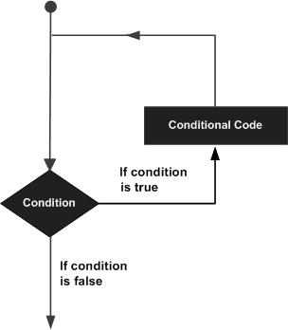
What is it?
Print “Bangladesh” 100 times
Add two numbers with different values each time
Repeats a block of code until a specified condition is met

Slide 3
Types
FOR
While
Do..While

Slide 4
LOOP statements
Initialize
Stopping condition
Increment
Break
Continue
Goto

Slide 5
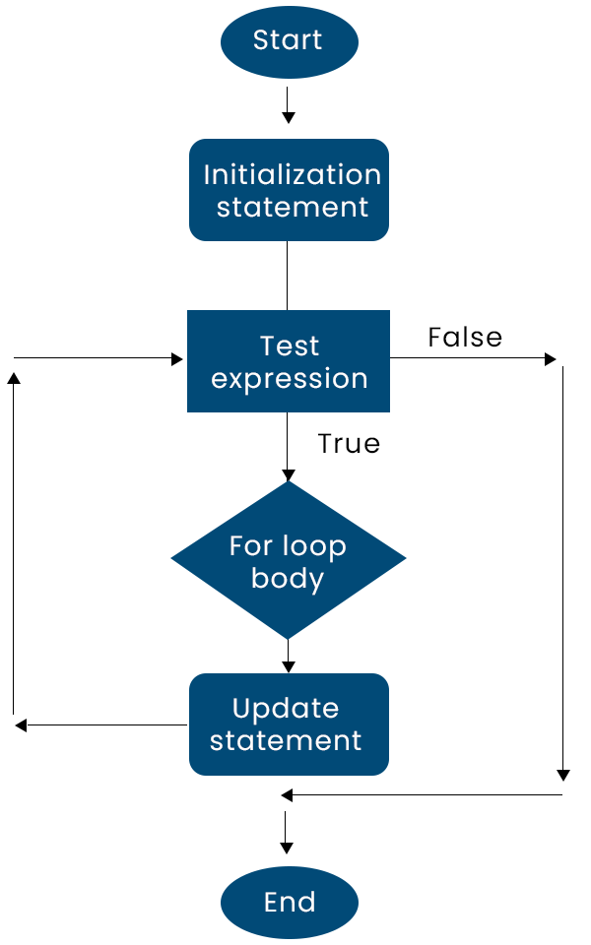
FOR LOOP
for (initializationStatement; testExpression; updateStatement) {
// statements inside the body of loop
}
Initialization statement → executed only once.
Test expression
False? → loop is terminated
True?
Inside codes are executed
Update expression is updated.
Again the test expression is evaluated.
This process goes on until the test expression is false. When the test expression is false, the loop terminates

Slide 6
// Print numbers from 1 to 10
#include <stdio.h>
int main() {
int i;
for (i = 1; i < 11; ++i) {
printf("%d ", i);
}
return 0;
}
i= ? | i< 11 ? | Inside Code | Update [ ++i ]
1 | True | Print i → 1 | 1+1 = 2
2 | True | Print i → 2 | 2+1 =3
3 | True | Print i → 3 | 3+1 = 4
4 | True | Print i → 4 | 4+1 = 5
5 | True | Print i → 5 | 5+1 =6
6 | True | Print i → 6 | 6+1 =7
7 | True | Print i → 7 | 7+1 = 8
8 | True | Print i → 8 | 8+1 =9
9 | True | Print i → 9 | 9+1 =10
10 | True | Print i → 10 | 10+1 =11
11 | False [Break]

Slide 7
/* Program to calculate the sum of first n natural numbers Positive integers 1,2,3...n are known as natural numbers */
#include <stdio.h>
int main() {
int num, count, sum = 0;
printf("Enter a positive integer: ");
scanf("%d", &num);
// for loop terminates when num is less than count
for(count = 1; count <= num; ++count) {
sum += count;
}
printf("Sum = %d", sum);
return 0;
}
count ? | count<= 5 ? | Inside Code | Update [ ++count ]
1 | True | Sum [old] = 0, Sum [new] = 0+1=1 | Count = 1+1=2
2 | True | Sum [old] = 1 Sum [new] = 1+2 =3 | Count =3
3 | True | Sum [old] = 3 Sum [new] = 3+3 =6 | Count =4
4 | True | Sum [old] = 6 Sum [new] = 6+4 =10 | Count=5
5 | True | Sum [old] = 10 Sum [new] = 10+5 =15 | Count=6
6 | False [Break]

Slide 8
#include <stdio.h>
int main()
{
int a,b,c;
for(a=0,b=12,c=23;a<2;a++)
{
printf("%d ",a+b+c);
}
}
Output
35 36
#include <stdio.h>
int main()
{
int i=1;
for(;i<5;i++)
{
printf("%d ",i);
}
}
Output
1 2 3 4

Slide 9
#include <stdio.h>
int main()
{
int i,j,k;
for(i=0,j=0,k=0;i<4,k<8,j<10;i++)
{
printf("%d %d %d\n",i,j,k);
j+=2;
k+=3;
}
}
Output
0 0 0
1 2 3
2 4 6
3 6 9
4 8 12
#include <stdio.h>
int main()
{
int i;
for(i=0;;i++)
{
printf("%d",i);
}
}
Output
infinite loop

Slide 10
#include<stdio.h>
void main ()
{
int i=0,j=2;
for(i = 0;i<5;i++,j=j+2)
{
printf("%d %d\n",i,j);
}
}
Output
0 2
1 4
2 6
3 8
4 10
PROBLEMS
Write a C program to compute the sum of the first 10 natural numbers.
Write a program in C to read 10 numbers from the keyboard and find their sum and average.
Write a program in C to display the cube of the number up to an integer.
Write a C program to display the n terms of odd natural numbers and their sum.

Slide 11
NESTED FOR LOOPS
#include <stdio.h>
void main() {
int i,j,rows;
printf("Input number of rows : ");
scanf("%d",&rows); for(i=1;i<=rows;i++){
for(j=1;j<=i;j++)
printf("%d",j);
printf("\n");
}
}
OUTPUT
1
12
123
1234

